Slide 1

Rules of Sale

Slide 2
Concept of Sale

Slide 3
Definition of Sale
    Sale is defined in Shariah as
      “Exchange of a thing of value, by another thing of value, with mutual consent”
      Permissibility
“Allah has permitted Sale (trade) and prohibited Riba”
(Al Baqarah)

Slide 4
Types of Sale
Valid sale ( Bai Sahih)
Void/Non existing Sale ( Bai Baatil )
Existing sale but void due to defect ( Bai Fasid )
Valid but disliked sale ( Bai Makrooh )

Slide 5
Valid Sale
VALID SALE ( Bai Sahih)
  a sale is valid if all elements together with their conditions are present
  elements of valid sale are
    Contract ( Aqd )
    Subject matter ( Mabe’e)
    Price ( Thaman )
    Possession or delivery ( Qabza )

Slide 6
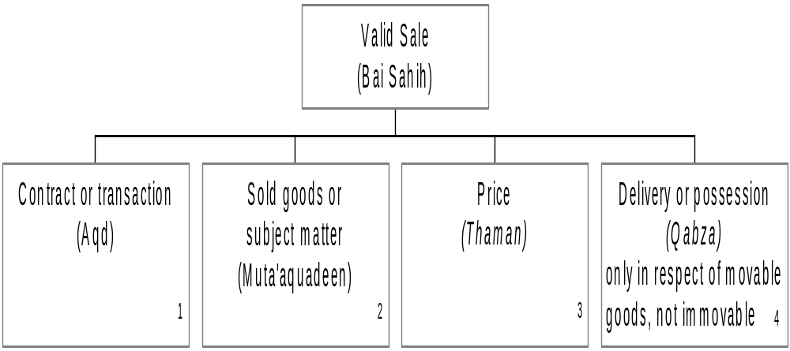
Valid Sale

Slide 7
Element of a Valid Sale
  CONTRACT ( Aqd )
    Offer & Acceptance ( Ijab-o-Qobool)
      Oral ( Qauli )
      Implied ( hukmi )
    Buyer and seller ( Muta’aquadeen ) must be
      Sane
      Mature
    Conditions of contract ( Sharaet-e-Aqd )
      sale must be non-contingent
      sale must be immediate
Notes:
Contract or transaction (Aqd)
1.1Offer & acceptance (Ijab-o-Qobool): The term “Offer” means that one person proposes to either sell his commodity to another person or buy from him and “Acceptance” means that the person who has been offered gives his approval of the proposal. Offer and acceptance are always done in past tense eg. “I have sold” or “I have purchased” etc. There are two ways of doing it:
1.1.1 Oral (Qauli): By saying.
1.1.2 Implied (Isharaa): By indicating. This is of two types:
1.1.1(a) Credit Sale (Istijrar) for eg. settlement of the bill at the end of the month.
1.1.1(b) Hand-to-Hand Sale (Taati): Exchange of money with goods without uttering Ijab-o-Qobool for eg. procedure adopted in contemporary stores.
1.2 Buyer & seller (Muta’aquadeen): Both must be :
1.2.1 Sane : Should be mentally sound at the time of contract.
Mature : Should be adult, however, if minor, must understand

Slide 8
Element of a Valid Sale
2. SOLD GOOD OR SUBJECT MATTER ( Mube’e )
    Existing
    Valuable
    Usable
    Capable of ownership/title
    Capable of delivery/possession
    Specific & Quantified
    Seller must have title & risk
Notes:
1.1 Existable
The subject matter of sale must be existing at the time of sale. Thus, a thing which has not yet come into existence cannot be sold. If a non-existent thing has been sold, even with mutual consent, the sale is void according to shari’ah. Eg. ‘A’ sells the unborn calf of his cow to ‘B’. The sale is void.
1.2 Valuable
The subject of sale must be a property of value. Thus a thing having no value according to the usage of trade eg. a leaf or a stone on a roadside cannot be sold or purchased.
1.3 Usable
The subject of sale should not be a thing which is not used except for a haram purpose, like pork, alcohol etc.
2.4 Capable of ownership/title
The subject matter should not be anything which is not capable of ownership/title for eg. sea or sky.
2.5 Capable of delivery/possession
For eg. an unconstructed building cannot be possessed since it is non-existent.

Slide 9
Element of a Valid Sale
3. PRICE ( Saman )
    Quantified ( Maloom )
    Specified & certain ( Muta’aiyan )
Notes:
Price (Thaman)
3.1 Quantified (Maloom): The measuring unit of the price should be known Eg. currency etc.
3.2 Specified & certain (Muta’aiyan): For a sale to be valid, the price should be ascertained and specified eg. the total amount etc. If the price is uncertain, the sale is void. Eg. ‘A’ says to ‘B’: “If you pay within a month, the price is Rs.50 but if you pay after two months, the price is Rs.55”. ‘B’ agrees. The price in this case is uncertain and therefore the sale is void unless any one of the two alternatives is agreed upon by the parties at the time of sale.

Slide 10
Element of a Valid Sale
4. DELIVERY OR POSSESSION (QABZA)
    Physical ( Haqiqi )
    Constructive ( Hukmi )
Notes:
The subject of sale must be in the physical or constructive possession of the seller when he sells it to another person. This is done only in respect of movable goods, not immovable.
4.1 Physical (Haqiqi): For eg. ‘A’ has purchased a car from ‘B’. ‘B’ has not yet delivered it to ‘A’ or to his agent. However, ‘A’ cannot sell the car to ‘C’. If he sells it before taking its delivery from ‘B’, the sale is void.
4.2 Constructive (Hukmi): “Constructive possession” means a situation where the possessor has not taken the physical delivery of the commodity, yet the commodity has come into his control and all the rights and liabilities of the commodity are passed on to him, including the risk of its destruction. For eg. ‘A’ has purchased a car from ‘B’. ‘B’ after identifying the car has placed it in a garage to which ‘A’ has free access and ‘B’ has allowed him to take the delivery from that place whenever he wishes. Thus the risk of the car has passed on to ‘A’. The car is in the constructive possession of ‘A’. If ‘A’ sells the car to ‘C’ without acquiring physical possession, the sale is valid.

Slide 11
BASIC RULES OF SALE

Slide 12
Rules of Sale
    Sale is defined in Shariah as
      “Exchange of a thing of value, by another thing of value, with mutual consent”

Slide 13
Rules of Sale
RULES RELATED TO SUBJECT MATTER(1-7)
Rule 1
  The subject of sale must exist at the time of sale
  For Example, “A” sells the unborn calf of his cow to “B”,the sale is invalid.
Rule 2
  The subject of sale must be in the ownership of seller at the time of sale. Hence, what is not owned by the seller cannot be sold.

Slide 14
Rules of Sale
  For Example, “A” sells to “B” a car which is presently owned by “C”, but which “A” intends to purchase from “C”. Since the car is not owned by “A” at the time of sale, the sale is void.
Rule 3
  The subject of sale must be in the physical or constructive possession of seller at the time of sale.

Slide 15
Rules of Sale
  “Constructive Possession” means where the buyer has not taken physical delivery of goods, but the goods are under his control. And all rights and liabilities of the goods have passed to him,i.e. the goods are at his risk.
  For Example, “A” has purchased a car from “B”, “B” has not physically handed over the car to “A” but has placed it at a garage which is in control of “A”. “A” can access the car whenever he wants to do so. The risk of the car has practically passed to “A”, the car is in the “Constructive Possession” of “A”,now “A” can sell the car to third party.

Slide 16
Rules of Sale
Rule 4
  The delivery of the sold commodity to the buyer should be certain and should not depend on a contingency or chance.
  For Example, “A” sells his stolen car to a person in hope that he will manage to get it back, the sale is void.

Slide 17
Rules of Sale
Rule 5
  The subject of sale should be an object of value. A thing having no value according to the usage of trade cannot be sold.
Rule 6
  The subject of sale should not be a thing used for a Haram purpose, e.g. pork, wine etc. The subject should be Maal-e-mutaqawwam

Slide 18
Rules of Sale
Rule 7
  The subject of sale should be specifically known and identified to the buyer. The subject of sale must be identified by pointing out or by detailed specification which can distinguish it from other things not sold.
  For Example, “A” points to a building and says to “B”: ‘I sell one of the apartments in this building to you’. The sale is void unless the apartment is specifically identified to the buyer.

Slide 19
Rules of Sale
RULES OTHER THAN SUBJECT MATTER (8-10)
Rule 8
  The sale must be instant and absolute. Thus a sale attributed to a future date or a sale contingent on a future event is void.
  For Example, “A” says to “B” on the 1st of January:” I sell my car to you on the 1st of February”. The sale is void, because it is contingent on a future event.

Slide 20
Rules of Sale
Rule 9
  The certainty of price is a necessary condition for the validity of sale.
  For Example, “A says to “B”: ‘If you pay in one month, the price is Rs50, but if you pay in 2 months the price is Rs55’. The price is uncertain and the sale is void.
  “A” can give the two options to “B”, but then “B” must select one option to validate the sale.

Slide 21
Rules of Sale
Rule 10
  The sale must be unconditional. A conditional sale is invalid, unless the condition is recognised as a usual practice of trade
  For Example, “A” buys a refrigerator from “B” with a condition that “B” undertakes its free service for 2 years. The condition, being recognized as a part of the transaction, is valid and the sale is lawful.

Slide 22
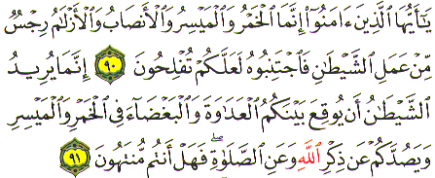
Gambling & Risk
  O believers! Intoxicants and gambling and Al Ansab (Animals sacrificed for idols) and Al Azlam (arrows for seeking luck or decision) are an abomination of Satan's handiwork. So avoid them in order that you may be successful. Satan wants only to excite enmity and hatred between you with intoxicants and gambling and hinder you from the remembrance of Allah and from prayer. So, will you not then abstain? (Al Maidah 90 – 91)

Slide 23
Ahadith on Gambling & Risk
“Whoever buys foodstuff, let him not sell it until he has possession of them” (Bukhari)
“Do not buy fish in the sea, for it is gharar” (Bukhari)
‘He who purchases food shall not sell it until he weighs it” (Muslim)
The Prophet forbade the sale of grapes until they become black and the sale of grain until it is strong (Bukhari, Muslim, Abu Dawood, Tirmidhi)

Slide 24
Promise to Sell
Difference between “Sale” and “Promise to sell”
  A sale cannot be effected unless the above mentioned conditions are fulfilled.
  But one can Promise to Sell something which is not owned by him.
  The promise initially creates a moral obligation
  If the promise has resulted in the Promisee incurring some liability, some jurists allow that the Promisor be legally forced to fulfill the promise.

Slide 25
Promise to Sell
  In case of a promise to sell the sale transaction will take place at a future date through a separate offer and acceptance
Exceptions to the rule
The above-mentioned rules of sale are relaxed in following two types of sale:
  Bai Salam
  Istisna

Slide 26
Valid Sale
      A valid sale contract exhibits two features:
      a) Knowledge; i.e. parties’ full knowledge of the object of sale
b) Existence; a concrete sale object
Absence of these features introduces Gharar in the transaction.

